Slide 1
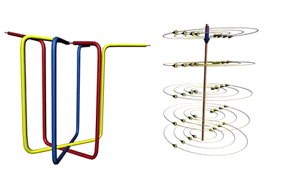
Induction Motor
Understanding Rotating magnetic field
Wire carrying current produces magnetic field around it
3 wires connected to each other at 120 degrees
3 phase power supplied to them
Variation in AC current takes different orientation and RMF IS seen.
Rotational speed of magnetic field is known as Synchronous speed.
Place a loop and EMF will be produced which will rotate the loop.

Slide 2
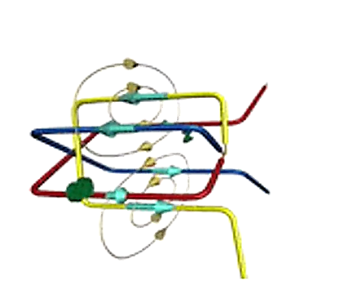
Induction Motor
Understanding Rotating magnetic field
Wire carrying current produces magnetic field around it
3 wires connected to each other at 120 degrees
3 phase power supplied to them
Variation in AC current takes different orientation and RMF is seen.
Rotational speed of magnetic field is known as Synchronous speed.
Place a loop and EMF will be produced which will rotate the loop.

Slide 3
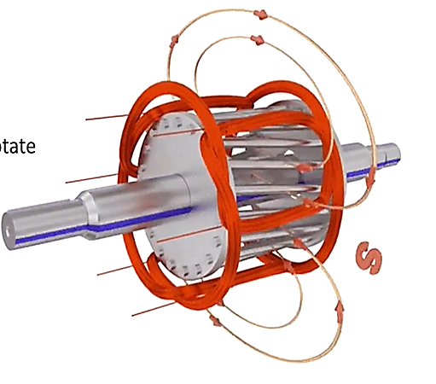
Working
Instead of loop we use squirrel cage rotor
3 Phase AC supply passes through stator
Rotating magnetic field is produced
Current will be induced in the bars and rotor will start to rotate
Electromagnetic induction takes place
Hence, called Induction motor

